Slide 1

Team Details
Localhost:3000
Thanus Kumaar A
Open Innovation for a better tomorrow

Slide 2

SustAIn
As AI usage continues to rise - especially in the form of large language models and generative tools - users remain unaware of the hidden environmental cost associated with their queries. SustAIn addresses this gap through a simple yet powerful solution.
SustAIn is a Chrome extension that tracks and displays the estimated energy, carbon emissions, and water consumption of AI queries made by users on popular platforms. The extension uses well-established research, formulas, and a query classification AI model hosted on Vertex AI to calculate these sustainability metrics in real-time.
By providing transparent, accessible insights directly in the user's browser, SustAIn empowers individuals and organizations to become more mindful of their AI usage and make environmentally informed decisions.

Slide 3
How different is it from any of the other existing ideas?
While several tools exist to track carbon footprints in general cloud services, SustAIn stands out as the first browser-based solution focused specifically on the sustainability of AI usage.
Unlike platforms that assess full-scale infrastructure emissions, our lightweight Chrome extension provides real-time feedback at the query level, focusing on generative AI tools like ChatGPT, Gemini, and others. There are no existing extensions that track or visualize the environmental impact of AI queries for end-users in this focused, accessible way.
How will it be able to solve the problem?
SustAIn solves the awareness gap in AI's environmental cost by making sustainability metrics visible, relatable, and real-time. It uses research-backed estimates and contextual comparisons (like energy used vs. household appliances or water used vs. bottles) to help users understand the consequences of their AI usage.
By embedding this insight directly in their browsing experience, users are empowered to make conscious choices, potentially reducing unnecessary or excessive AI interactions and promoting more sustainable habits.
USP of the proposed solution
First-of-its-kind Chrome Extension providing sustainability insights specifically for AI and LLM usage.
Real-time environmental metrics (energy, water, CO₂) shown for individual AI queries.
Backed by proven methodologies using data simulations, open APIs, and published research.
Non-intrusive and easy to adopt—no need for backend integration or platform-level access.
Scalable and embeddable, allowing businesses to integrate the sustainability widget into their own dashboards or apps.

Slide 4
List of features offered by the solution
Sustainability Insights Right Inside Your Browser SustAIn is a lightweight Chrome extension that helps users monitor their digital sustainability impact in real time. It integrates seamlessly into the browser to provide context-aware feedback and actionable insights without disrupting the browsing experience.
Real-Time Carbon Emission Tracking SustAIn uses the Electricity Maps API to estimate the carbon emissions generated by user activities, based on real-time data from regional energy grids.
Location-Aware Energy Profiling By identifying the geolocation of the connected data centers via IP-API, the extension evaluates the sustainability profile of the energy infrastructure being used.
Power Usage Effectiveness (PUE) Estimation Using time zone data from TimeAPI, the extension estimates the Power Usage Effectiveness (PUE) of data centers — offering users insights into how efficiently energy is consumed.
Custom AI Model for Sustainable Browsing SustAIn deploys a lightweight, AutoML-trained query classification model via Google Cloud Vertex AI. It classifies user queries directed to AI models into categories (e.g., text, image, code), helping estimate their sustainability impact — all without relying on large-scale LLMs.
Built for Sustainability at Every Layer The entire system — from model design to API integration — is optimized for low resource consumption. SustAIn intentionally avoids heavyweight

Slide 5
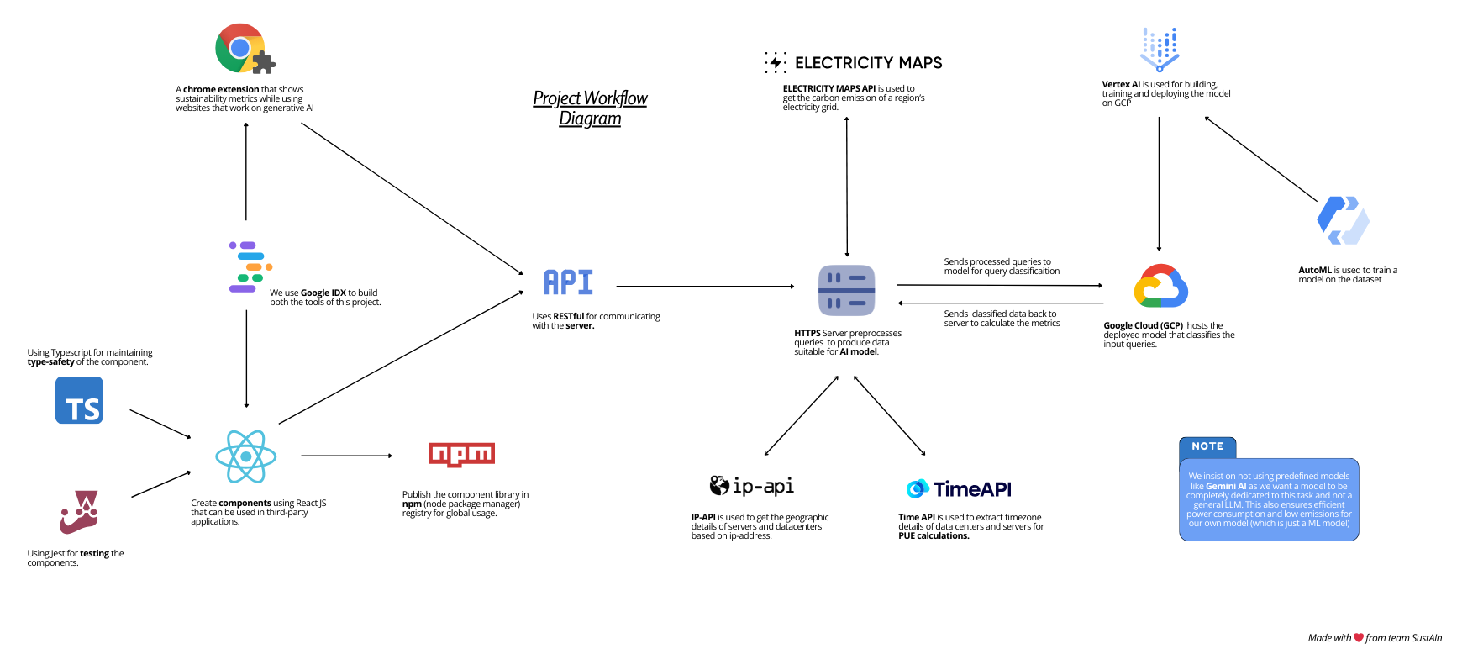
Process flow diagram

Slide 6
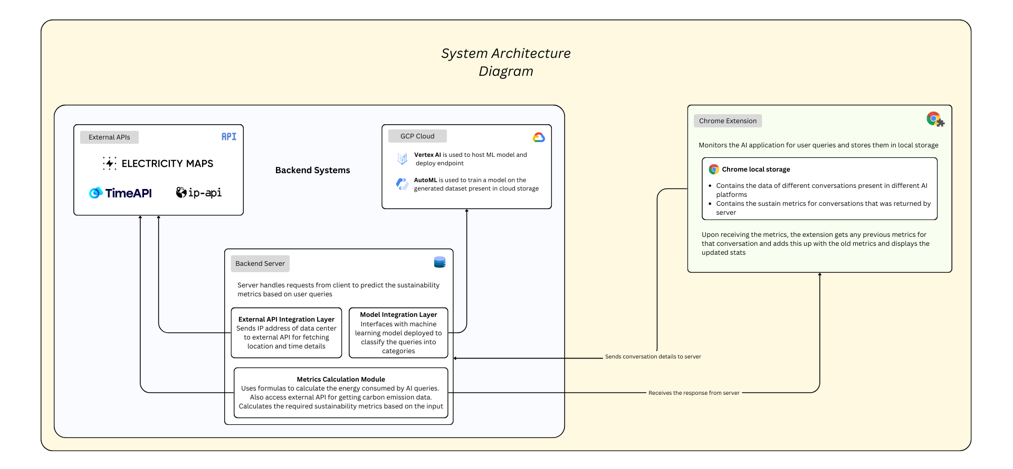
Architecture diagram

Slide 7
Technologies used
Layer | Technologies
Chrome Extension | React JS, Manifest v3
Backend | Express JS
ML Pipeline | GCP Vertex AI, AutoML
External APIs | Electricity Maps, IP-API, TimeAPI
DevOps & Hosting | Google Cloud Platform (GCP), GitHub Pages

Slide 8
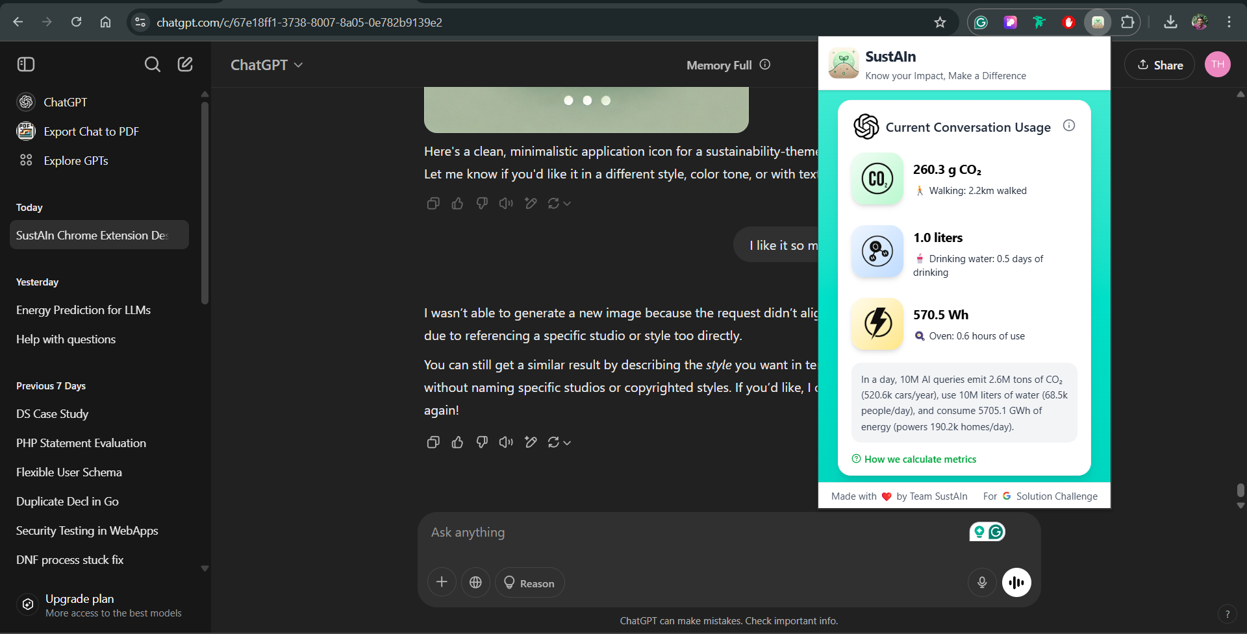
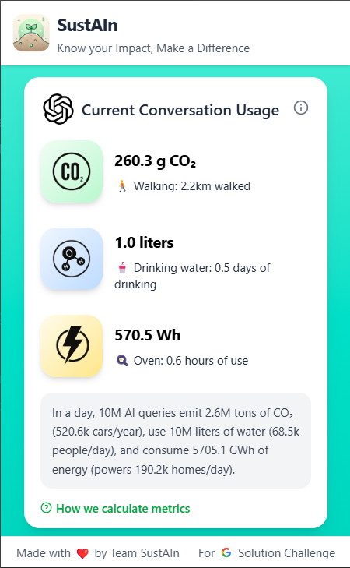
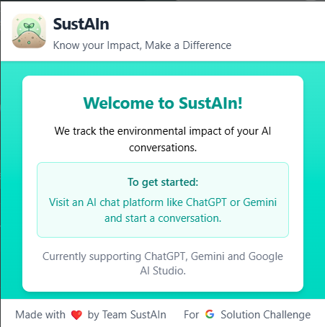
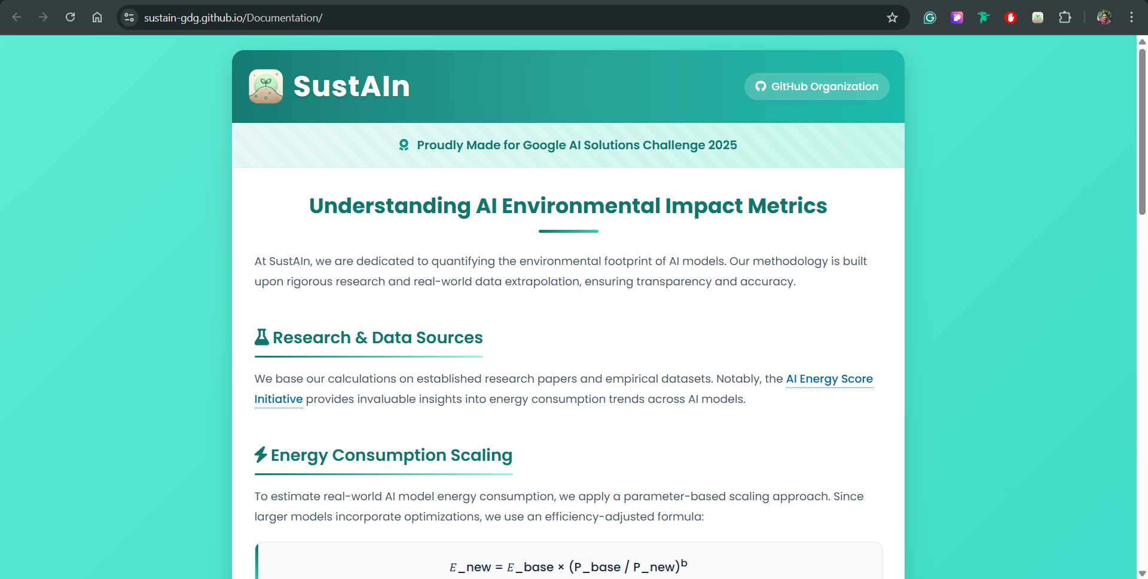












Snapshots of the MVP
Fig 1.1 – Screenshot showing extension in action
Fig 1.3 – Content of extension when not using AI tools
Fig 1.4 – Screenshot of documentation page
Fig 1.2 – Contents of extension when using AI tools

Slide 9
Future Development
Develop a reusable component library to help developers integrate sustainability metrics into their own tools and dashboards.
Extend sustainability insights to mobile platforms through integration with AI assistants like ChatGPT, Google Assistant, and similar tools—enabling real-time environmental feedback.
Expand support to a broader range of generative AI platforms such as Leonardo AI, Claude, and other emerging tools—beyond current support for ChatGPT, Gemini, and AI Studio.
Partner with major cloud providers (e.g., AWS, GCP, Azure) to offer region-specific sustainability analytics for model training and deployment.

Slide 10
GitHub Public Repository
https://github.com/SustAIn-GDG/SustAIn-Chrome-Extension
Demo Video Link (3 Minutes)
https://youtu.be/3VcPr41grGU
MVP Link
https://chromewebstore.google.com/detail/bhjkhbmcamcpeebfobejnhnkghkfhegp

Slide 11


